Slide 1
Unit-II Introduction to Big Data Analytics
1

Slide 2
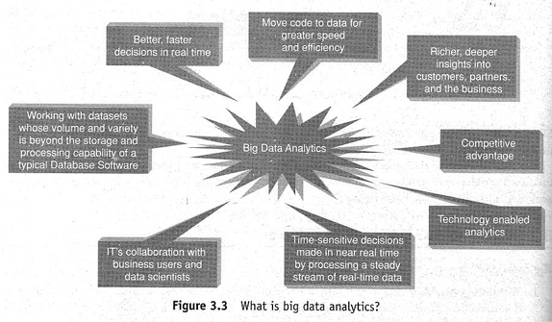
Big Data Analytics
What is Big Data Analytics?
Big Data Analytics is the process of collecting, processing, analyzing, and interpreting very large and complex datasets to discover patterns, relationships, trends, and actionable insights.
Traditional analytics generally works with structured data stored in relational databases. Big Data Analytics extends this capability to:
Structured data
Semi-structured data
Unstructured data
Batch data
Streaming/real-time data

Slide 3
Basic Pipeline of Data Analytics
Data Sources
↓
Data Collection
↓
Data Storage
↓
Data Processing
↓
Data Analysis
↓
Pattern / Knowledge Discovery
↓
Visualization
↓
Decision Making
Example
An e-commerce company collects:
Customer transactions
Search history
Product reviews
Product images
Website clicks
Mobile-app activity
Big Data Analytics can combine these sources to determine:
"What products is a customer most likely to purchase next?"
3

Slide 4
Objectives of Big Data Analytics
The primary objectives are:
1. Discover Hidden Patterns
Identify relationships that are not immediately visible.
2. Predict Future Events
Use historical data to forecast future outcomes.
3. Improve Decision-Making
Provide evidence-based information to managers.
4. Improve Customer Experience
Understand customer behavior and preferences.
5. Detect Anomalies
Identify fraud, cyberattacks, equipment failures, etc.
6. Optimize Operations
Improve resource utilization and reduce operational costs.
4

Slide 5
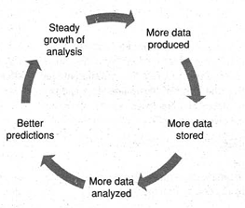

Classification Big Data Analytics
5

Slide 6
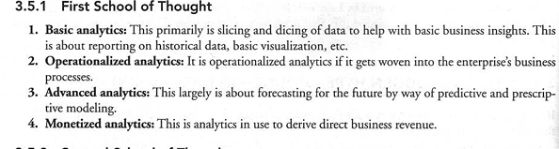

Slide 7
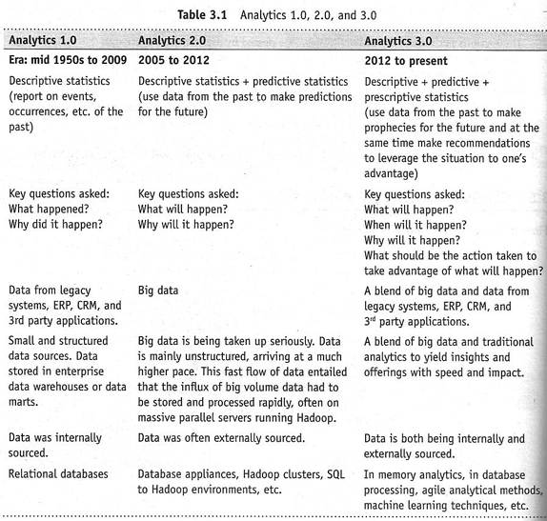
7

Slide 8
Major Challenges in Big Data Environment
The challenges that organizations face when designing and implementing Big Data storage and processing systems:
Scale
Security
Schema
Continuous Availability
Consistency
Partition Tolerance
Data Quality
These challenges are especially important when choosing between RDBMS, NoSQL databases, distributed storage systems, and cloud-based Big Data platforms.
8
24-08-2026
Add a footer

Slide 9
Scale – Ability to handle increasing data and workloads; horizontal scaling is commonly used.
Security – Protecting sensitive data using authentication, authorization, encryption, and auditing.
Schema – Handling diverse and changing data structures; schema-on-read provides flexibility.
Continuous Availability – Maintaining 24/7 service through replication, redundancy, and failover.
Consistency – Ensuring appropriate correctness of data across distributed replicas; systems may use strong or eventual consistency depending on requirements.
Partition Tolerance – Continuing operation despite network failures between distributed nodes; this is a fundamental concern addressed by the CAP theorem.
Data Quality – Ensuring accuracy, completeness, consistency, validity, timeliness, and proper metadata.
9
24-08-2026
Add a footer

Slide 10
Major Challenges in Big Data Environment
Challenge | Key Question | Main Concern
Scale | Can the system handle increasing data? | Scalability (horizontal, vertical)
Security | Is the data protected? | Confidentiality & access(
Schema | Can different data structures be handled? | Flexibility
Availability | Is the system available 24/7? | Downtime
Consistency | Do users see appropriate correct data? | Data correctness
Partition Tolerance | Can the system survive network failures? | Distributed reliability
Data Quality | Is the data accurate and usable? | Accuracy, completeness, timeliness
10
24-08-2026
Add a footer

Slide 11
TERMINOLOGIES USED IN BIG DATA ENVIRONMENTS
In-Memory Analytics
Data access from non-volatile storage such as hard disk is a slow process. The more the data is required to be fetched from hard disk or secondary storage, the slower the process gets. One way to combat this challenge is to pre-process and store data (cubes, aggregate tables, query sets, etc.) so that the CPU has to fetch a small subset of records. But this requires thinking in advance as to what will be required for analysis. If there is a need for different or more data, it is back to the initial process of pre-computing and storing data or fetching it from secondary storage.
This problem has been addressed using in-memory analytics. Here all the relevant data is stored in Random Access Memory (RAM) or primary storage, thus eliminating the need to fetch data from hard disk. The advantage is faster access, rapid deployment, better insights, and minimal IT involvement.
11

Slide 12
TERMINOLOGIES USED IN BIG DATA ENVIRONMENTS
In-Database Processing
In-In-database processing is also called in-database analytics. It works by fusing data warehouses with analytical systems. Typically the data from various sources enterprise On Line Transaction Processing (OLTP) systems after this problem has been addressed using in-memory analytics.
Here all the relevant data is stored in Random Access Memory (RAM) or primary storage, thus eliminating the need to fetch data from hard disk. The advantage is faster access, rapid deployment, better insights, and minimal IT involvement.
Cleaning up (de-duplication, scrubbing, etc.) through the process of ETL is stored in the Enterprise Data Warehouse (EDW) or data marts. The huge datasets are then exported to analytical programs for complex and extensive computations. With in-database processing, the database program itself can run the computations, eliminating the need for export and thereby saving on time. Leading database vendors are offering this feature to large businesses.
Core Tasks in ETL Transformation
Data Scrubbing: Fixing spelling mistakes, trimming extra spaces, and correcting broken dates.
Standardization: Making formats uniform, such as changing phone numbers or state names to match one rule.
De-duplication: Finding and removing repeat records using exact keys or fuzzy logic matching.
Survivorship Rules: Deciding which record to keep when two matching entries have different value
12

Slide 13
TERMINOLOGIES USED IN BIG DATA ENVIRONMENTS
Symmetric Multiprocessor System (SMP)
In SMP, there is a single common main memory that is shared by two or more identical processors. The processors have full access to all I/O devices and are connected using a single operating system instance.
SMP are tightly coupled multiprocessor systems. Each processor has its own high-speed memory, called cache memory, and are connected using a system bus
Massively Parallel Processing Massive Parallel Processing (MPP)
Massively Parallel Processing Massive Parallel Processing (MPP) refers to the coordinated processing of programs by a number of processors working parallel. The processors, each have their own operating systems and dedicated memory. They work on different parts of the same program.
The MPP processors communicate using some sort of messaging interface. The MPP systems are more difficult to program as the executing segments must be divided in such a way that all the executing segments can communicate with each other.
13

Slide 14
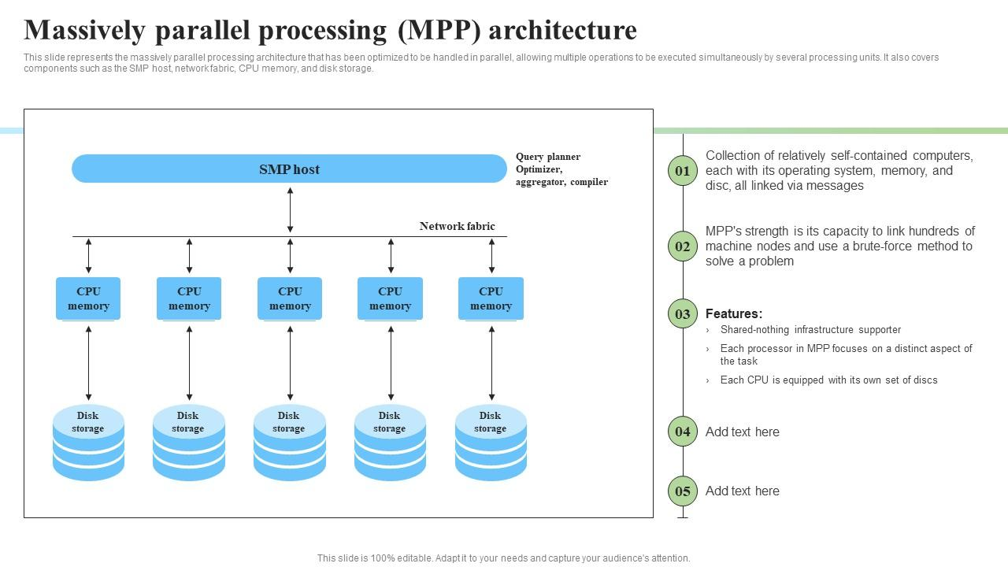
TERMINOLOGIES USED IN BIG DATA ENVIRONMENTS
Massively Parallel Processing Massive Parallel Processing (MPP)
Massively Parallel Processing (MPP) is a computing setup where many independent processors or nodes work on pieces of a big job at the same time. Each node has its own memory and operating system, and they talk to each other through a fast network to finish tasks quickly.
Key Parts of MPP Architecture
Master Node: Receives the user request, makes a plan, and sends work to the smaller nodes.
Compute Nodes: Separate servers that run their own tasks on small parts of the data.
Interconnect: A fast network cable system that lets nodes share info safely.
No Shared Memory: Each node works on its own data slice without slowing down other units.
14

Slide 15
CAP Theorem
CAP refers to:
C – Consistency
A – Availability
P – Partition Tolerance
The CAP theorem describes the trade-off that exists in a distributed system when a network partition occurs.
1. Consistency Consistency means that all nodes in a distributed system have access to the same, up-to-date data. For example, if data is updated on one node, the other nodes should reflect the updated value. Simple meaning: All users should see a consistent view of the data. | 2. Availability Availability means that the system continues to respond to requests, even when some components of the system experience failures. For example, if one server becomes unavailable, another server should still be able to provide the required service. The system should always be available to respond to requests.
3. Partition Tolerance Partition tolerance refers to the ability of a distributed system to continue functioning when there is a failure in communication between nodes. The nodes cannot communicate with each other, but the distributed system should be designed to handle this situation. The system should continue operating even when communication between nodes is interrupted.
15

Slide 16
The CAP Trade-off
The fundamental idea is that a distributed system cannot guarantee all three properties simultaneously when a network partition occurs.
When a partition occurs, the system has to make a choice:
CP — Consistency + Partition Tolerance
The system maintains consistent data even during a partition, but some requests may not be served.
C + P → Availability may be sacrificed
AP — Availability + Partition Tolerance
The system continues to respond to requests even during a partition, but different nodes may temporarily have different values.
A + P → Consistency may be sacrificed temporarily
16

Slide 17
BASE: Basically Available, Soft State, Eventual Consistency
In Advanced Operating Systems / Distributed Systems, BASE is an important concept for understanding how some large-scale distributed systems handle data consistency and availability.
BASE stands for:
B – Basically Available
S – Soft State
E – Eventual Consistency
It is useful to teach BASE in contrast to ACID and in connection with the CAP theorem.
Suppose a distributed system has three nodes: Even if Node 2 fails, the system can continue providing service using the other nodes.
17

Slide 18
1. Basically Available (BA) Basically Available means that the system provides a response to requests even when some components of the distributed system are experiencing failures. The system attempts to remain available rather than stopping completely. Example Even if Node 2 fails, the system can continue providing service using the other nodes. Basically Available = The system remains available even when some failures occur. | 2. Soft State (S) Soft State means that the state of the system may change over time, even without a new user request, because the state can be updated or synchronized by the system itself. Unlike a strictly consistent system, the data at different nodes may temporarily be different. Soft State = Data may temporarily change or differ while the system is synchronizing.
3. Eventual Consistency (E) Eventual Consistency means that the system may not provide the latest value immediately at every node, but if no new updates occur, all replicas will eventually become consistent. Eventual Consistency = Not necessarily consistent immediately, but becomes consistent eventually.
BASE
|
-----------------------------------------------
| | |
Basically Soft State Eventual
Available Consistency
| | |
Stay available Temporary Eventually
during failures state changes become consistent
18

Slide 19
BASIC ANALYTICS
Basic Analytics is the initial level of analytics in which existing or historical data is examined to understand business performance.
It mainly focuses on:
Collecting available data
Organizing data
Summarizing information
Generating reports
Identifying simple patterns
Visualizing historical performance
Basic analytics generally helps an organization understand its past and present situation.
Objectives of Basic Analytics
The major objectives are:
To understand historical business performance.
To summarize large quantities of data.
To identify trends and patterns.
To support routine managerial decisions.
To monitor Key Performance Indicators (KPIs).
To provide information through reports and dashboards.
19

Slide 20
BASIC ANALYTICS : Techniques Used
Basic Analytics commonly uses:
Reporting
Querying
Dashboards
Data visualization
Descriptive statistics
Aggregation
OLAP
Drill-down
Roll-up
Slice and dice
Example
A retail manager wants to know:
Total sales in 2025
Sales by region
Best-selling product
Monthly revenue
Number of customers
A dashboard can provide all this information.
This is Basic Analytics because the objective is to understand existing performance rather than predict future behavior.
20

Slide 21
ADVANCED ANALYTICS
Advanced Analytics uses sophisticated statistical, mathematical and computational techniques to discover deeper insights from data.
It goes beyond simple reporting.
Characteristics of Advanced Analytics:
Uses sophisticated analytical techniques.
Can work with large and complex datasets.
Identifies hidden relationships.
Predicts future events.
Supports complex decision-making.
Can use machine learning.
Can incorporate structured and unstructured data.
21

Slide 22
Types of Advanced Analytics
A. Diagnostic Analytics Why did it happen? Example: Sales decreased by 15%. Diagnostic analysis may identify: Competitor introduced a cheaper product. Advertising expenditure decreased. Product availability declined. Customer complaints increased. | B. Predictive Analytics What is likely to happen? It uses historical data to predict future outcomes. Examples: Predicting customer churn Predicting sales Predicting fraud Predicting equipment failure Predicting demand | C. Prescriptive Analytics What should we do? Prescriptive analytics recommends an appropriate action. Example: A bank predicts that a customer is likely to leave. The system may recommend: Provide a customized interest rate or retention offer.

Slide 23
Advanced Analytics Techniques
Important techniques include:
Statistical techniques
Regression
Correlation
Time-series analysis
Data mining
Classification
Clustering
Association analysis
Machine learning
Decision trees
Neural networks
Classification models
Recommendation systems
Optimization
Resource optimization
Pricing optimization
Route optimization

Slide 24
OPERATIONALIZED ANALYTICS
Operationalized Analytics means integrating analytical models and insights directly into an organization's operational/business processes.
The important idea is:
Analytics should not remain only in reports or analytical models; it should become part of everyday business operations.
Simple progression
Data → Analysis → Insight → Business Process → Action
Traditional analytics Data ↓ Analysis ↓ Report ↓ Manager ↓ Decision ↓ Action | Operationalized Analytics Data ↓ Analytical Model ↓ Decision ↓ Automatic/Embedded Action ↓ Business Process

Slide 25
MONETIZING ANALYTICS
Monetizing Analytics means using data and analytical capabilities to generate direct or indirect economic value.
The organization moves beyond:
"Analytics helps us make better decisions."
to:
"Analytics itself helps us generate measurable business value."
How Analytics Creates Value
Analytics can create value by:
Increasing revenue
Reducing costs
Improving customer retention
Improving pricing
Increasing productivity
Creating new products/services
Improving customer experience
Identifying new business opportunities

Slide 26
Methods of Monetizing Analytics
1. Personalized Marketing
Analyze customer behavior to provide targeted offers.
2. Cross-Selling
Identify products that existing customers are likely to purchase.
3. Up-Selling
Identify opportunities to move customers toward higher-value products.
4. Dynamic/Optimized Pricing
Use demand and customer information to support pricing decisions.
5. New Analytical Products
Organizations can incorporate analytics into products and services.
6. Improved Customer Retention
Predict customers who may leave and take preventive action.
4.4 Example — E-Commerce
Suppose an online retailer analyzes customer data.
It discovers:
Customers who purchase a mobile phone frequently purchase a protective case.
The system recommends the case.
Result:
Recommendation → Additional purchase → Increased revenue
Analytics has therefore generated economic value.

Slide 27
Analytics Value Chain
DATA
↓
ANALYTICS
↓
INSIGHT
↓
DECISION
↓
ACTION
↓
BUSINESS VALUE
↓
REVENUE / COST SAVINGS

Slide 28
MODIFYING BUSINESS INTELLIGENCE PRODUCTS TO HANDLE BIG DATA
Traditional Business Intelligence
Traditional BI typically follows:
Operational Data Sources
↓
ETL
↓
Data Warehouse
↓
OLAP / Analytics
↓
Reports / Dashboards
↓
Management Decision

Slide 29
Three Major Areas of Modification
For your presentation, explain the modification under three major areas:
1. Data
2. Analytical Algorithms
3. Infrastructure

Slide 30
MODIFICATION IN DATA HANDLING : Handling Different Types of Data
Traditional BI primarily works with structured data. Big Data BI must handle: Structured Data Examples: Customer tables,Sales records,Employee records Semi-Structured Data Examples: XML,JSON,Web logs Unstructured Data Examples: Text,Images,Audio,Video,Social-media content

Slide 31
Add a Slide Title - 4
31
24-08-2026
Add a footer

Slide 32
Add a Slide Title - 5
32
24-08-2026
Add a footer

